Slide 1
Grid Operation
Key Issues and Challenges
U K Verma
GM, ERLDC-POSOCO

Slide 2
Contents
Typical Numbers for Indian Power System
Growth of interconnected Indian power system
  NEW-SR grid synchronization and challenges
International connections
  Power transfer to Bangladesh and Challenges
Integration of renewables
Power system in extremities

Slide 3

Indian Power System : Amongst the Largest in the World
National Grid (UK)
61GW, 62 mln
PJM (USA)
164GW, 60 mln
SO - UPS (Russia)
157 GW, 144 mln
MidWest ISO (USA)
98GW, 39 mln
SGCC (China)
554GW, 1100 mln
CSG (China)
129 GW, 240 mln
RTE (France)
100GW, 65 mln
Tepco (Japan)
64GW, 45 mln
Red Electrica (Spain)
44GW, 46 mln
KPX (South Korea)
76GW, 50 mln
ONS (Brazil)
77GW, 189 mln
Terna (Italy)
57GW, 60 mln
PGCIL (India)
135 GW, 1200 mln
Eskom
(South Africa)
37 GW, 50 mln
The information for each member refers to peak load and customers served
Source: VLPGO, 2014

Slide 4
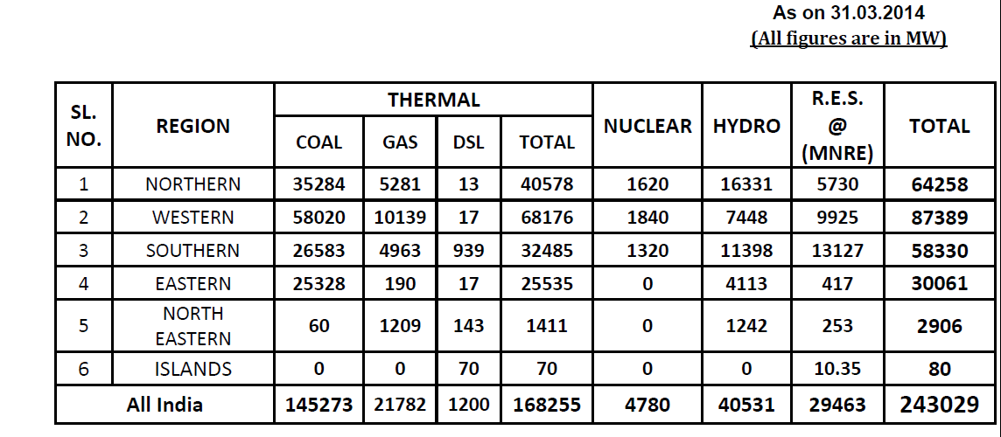
Region wise Installed Generating Capacity
Captive generating capacity as on 31st March 2011 = 34,445 MW
Source: CEA website

Slide 5
Owner wise Sector wise Breakup
All figure in MW
Source: CEA website

Slide 6
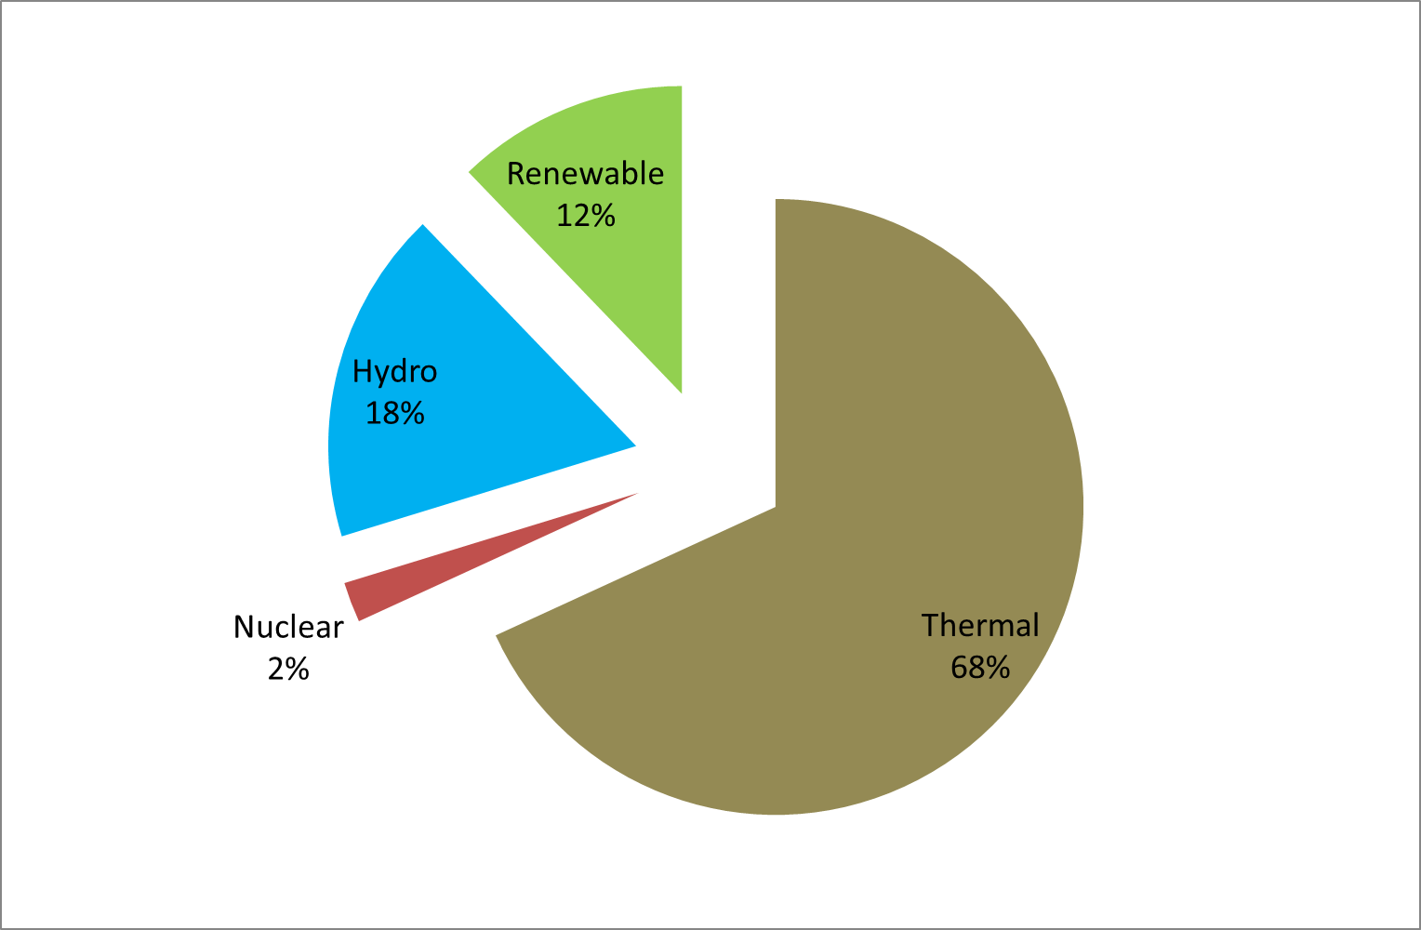
All India installed capacity breakup

Slide 7
Indian Power System (upto 132/110 kV level)
System Components | NEW Grid | SR Grid | Total(N-E-W-S)
Nodes | 4450 | 1335 | 6317
Generating Plants | 492 | 237 | 733
Machines | 1327 | 532 | 1862
Branches | 9031 | 3317 | 12348
Transformers | 1965 | 650 | 2615
Bus reactors | 197 | 46 | 243
Line reactors | 419 | 79 | 498
Voltage Level (in kV) | Central Sector | State Sector | JV/Pvt | Total
765 | 7771 | 411 | -- | 8182
400 | 79265 | 34685 | 8370 | 122320
220 | 10474 | 133413 | 830 | 144717
+- 500 Kv HVDC lines | 5948 | 1504 | 1980 | 9432
Line lengths in Ckt. Km.
As on 31st March 2014

Slide 8
Some Typical Numbers …
All India Installed Capacity :~ 243 GW
Peak Demand met :~ 129 GW
Max Wind Generation :~ 224 MU
Generation outage :~ 27000 MW
Energy : ~ 2650 MU/day
Hydro generation :~ 375 MU/day
400kV & above Trans. Line :~ 780 nos
Short Term Open Access :~ 240 MU/day
  Power Exchange volume : ~ 80 MU/day
  Bilateral volume : ~ 160 MU/day
Average figures

Slide 9
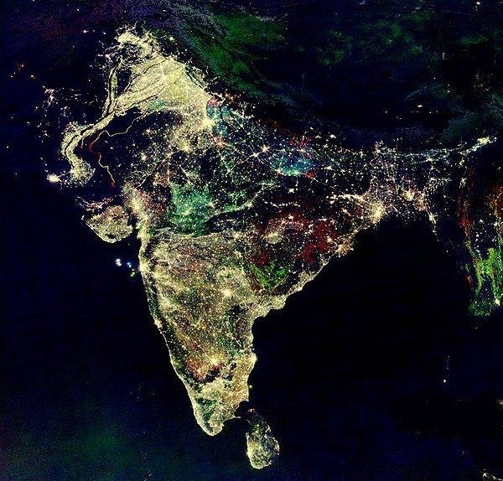
Arial view of Indian subcontinent in Night
Spatial Distribution Of Load
High load
density
Resource rich areas

Slide 10
Five Regional Grids
One Frequencies
31st December 2013
NEW grid synchronized
with SR grid
August 2006
North synchronized
With Central Grid
March 2003
West synchronized
With East & Northeast
NEW Grid
All India Grid
October 1991
East and Northeast
synchronized
North East West
Grid
MERGING
OF
MARKETS
South
Grid
Central Grid
North
Installed Capacity: 243 GW
East
West
Northeast
Inter – Regional
Capacity:
35 GW
Renewable: 31 GW
South
Five Regional Grids
Five Frequencies
Target 2020: 292 GW

Slide 11
Why Integration?
Obvious Benefits of Integrated Operation
Security
Reliability and quality of supply
  Suppression of frequency and voltage fluctuations
Sharing of resources
  Reduction in investment and conservation
  Economies of scale – Funding, Staggered Capacity
  Utilisation of diversities
  Environmental dispatch & new plant siting
  Coordination of maintenance schedules
Risk sharing
Merit order operation
Economical exchange of electric power

Slide 12
NEW and Southern Region Grid Synchronization

Slide 13
WR
Existing/Upcoming Network
ER
WARDHA
RAIGARH
AURANGABAD
RAIPUR
PUNE
PARLI
STERLITE
LONIKHAND
ROURKELA
SHOLAPUR
BHADRAWATI
TALCHER
GAJUWAKA
Transmission line in WR
765 kV Raipur-Warda D/C
765 kV Warda-Aurangabad D/C
400 kV Aurangabad-Pune D/C
400 kV Pune-Parli D/C
NAG’SAGAR
Transmission line in SR
765 kV Raichur-Kurnool S/C
765 kV Kurnool Thiruvalam D/C
400 kV Vijaywada-Nellor D/C
400 kV Nellor-Thiruvalam D/C
400 kV Gooty-Madhugiri D/C
KURNOOL
RAICHUR
VIJAYAWADA
MADHUGIRI
GOOTY
NELLORE
HIRIYUR
THIRUVALAM
NELAMANGALA
KOLAR
765 kV Line
YELHANKA
BIDADI
SHOLINGANALLUR
SOMANAHALLI
400 kV Line
765 kV Under construction Line
SALEM
500 kV HVDC Line
400 kV Under construction Line
SR

Slide 14
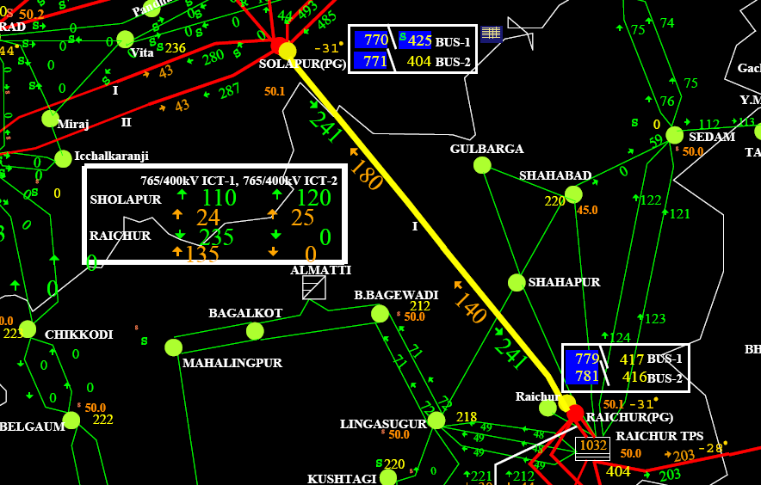
Successful synchronization of Southern Grid on 31st Dec 2013 at 20:25 hours (through 765 kV Raichur (SR)- Solapur (WR) S/C)

Slide 15
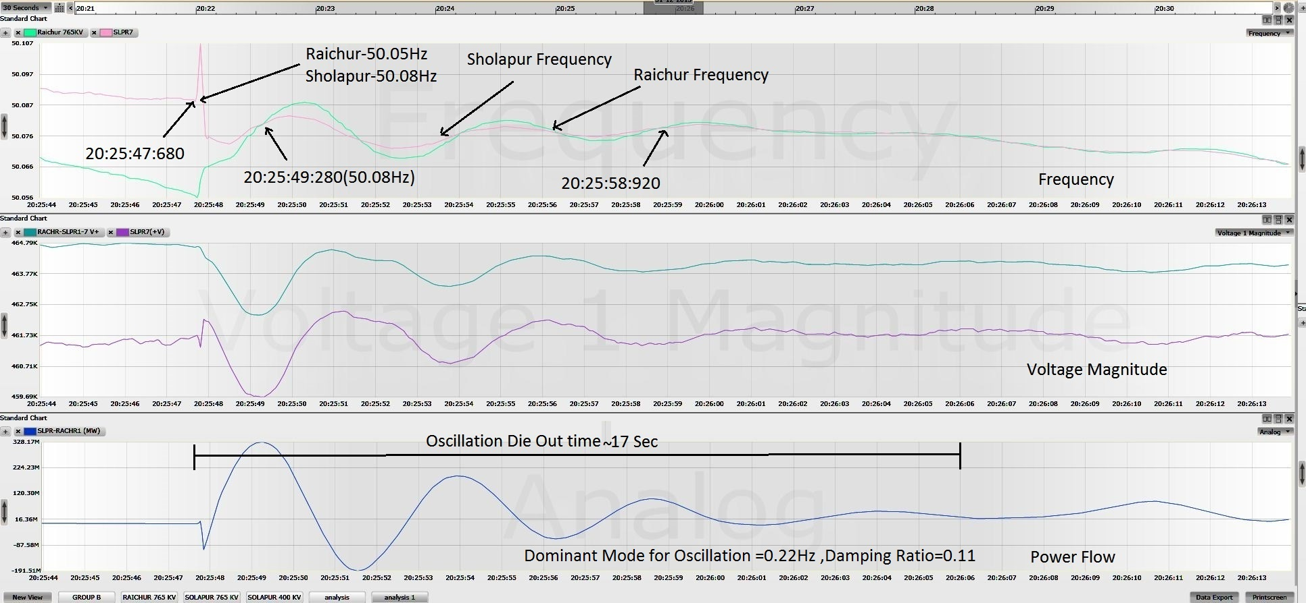
Synchronization of SR grid with NEW grid at 2025hrs on 31.12.13
328 MW
-191 MW

Slide 16
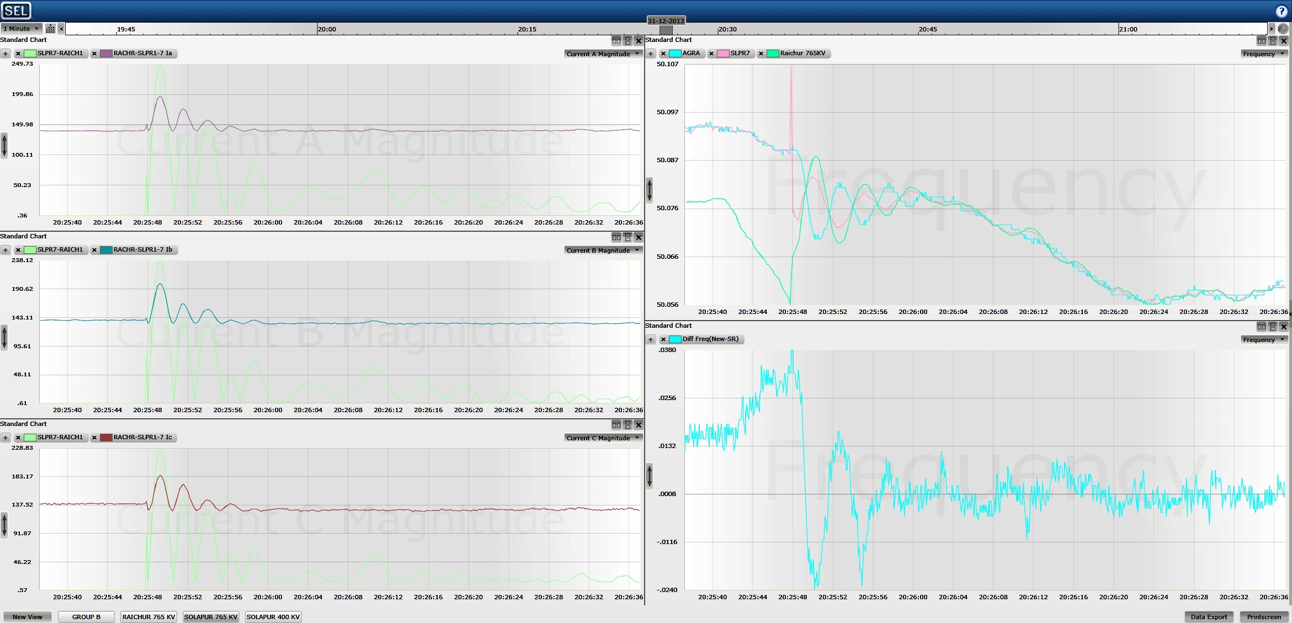

Instant of Synchronization at 2025 hrs.
Frequency Oscillations for 16s
Frequency difference of 0.034 Hz at the instant of Synchronization

Slide 17
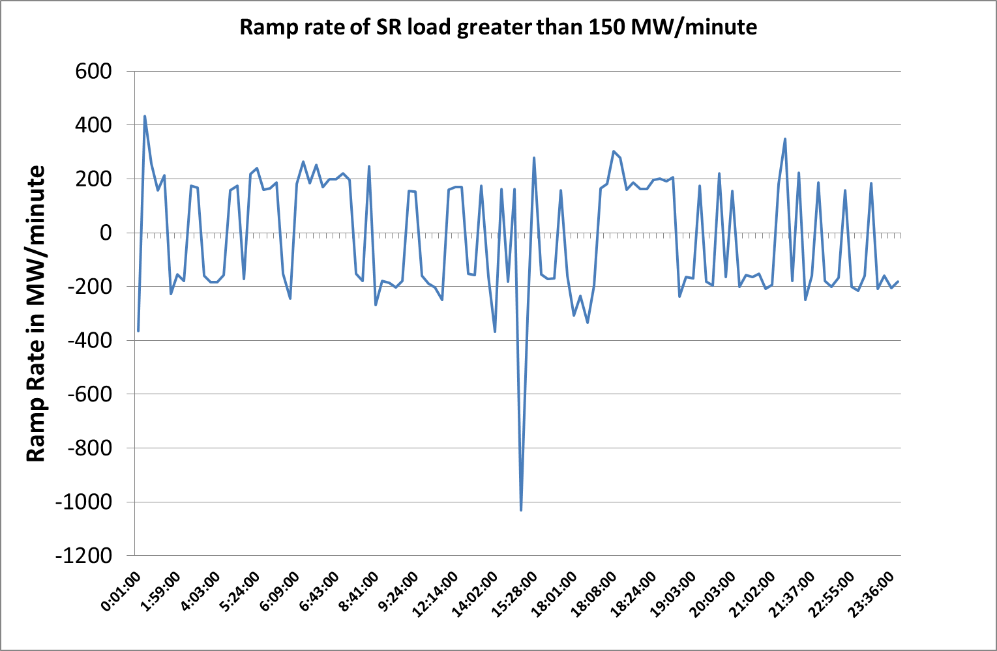

Slide 18
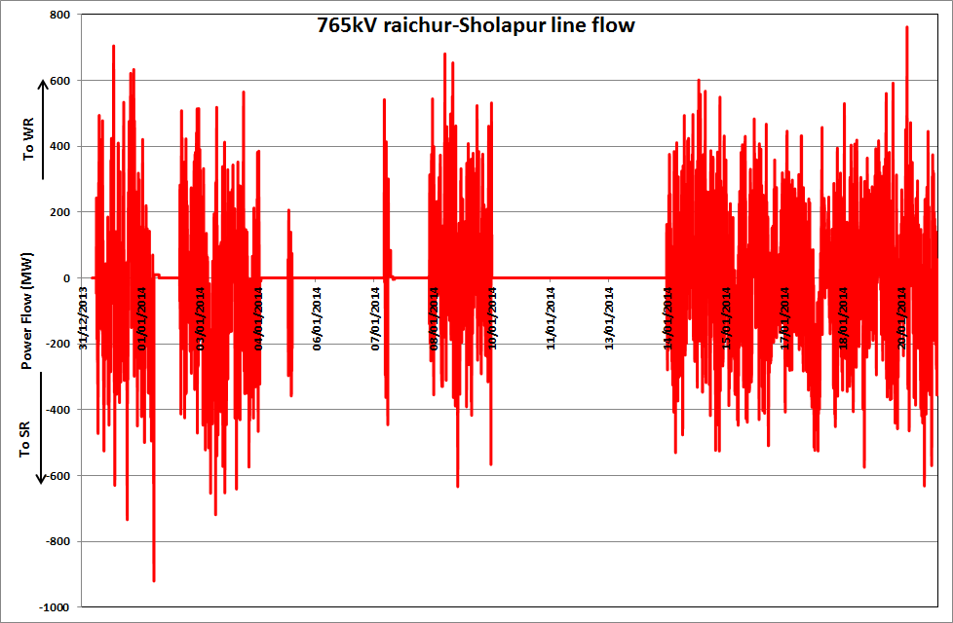
Up to 700 MW flow on 765 kV Sholapur-Raichur line in either direction
1st synchronization at 20:25 hrs on 31st Dec 2013
Re-synchronization at 20:23 hours on 2nd Jan’14
Re-synchronization at 19:56 hours on 8th Jan’14
Re-synchronization at 1754hrs on 07.01.14
Re-synchronization at 11:53 hours on 14th Jan’14
Re-synchronization at 10:41 hours on 5th Jan’14
Tripping due to Raichur ICTs at 12:54 hours on 5th Jan’14
Manually Opened at 0732 hrs on 10th Jan’14 during Talcher-Kolar HVDC Shutdown
Tripping of line on overcurrent at 05:33 hours on 2nd Jan’14
Tripping due to Raichur ICTs at 18:23 hours on 4th Jan’14
Tripping at 2130hrs on
7th Jan’14 on overcurrent

Slide 19
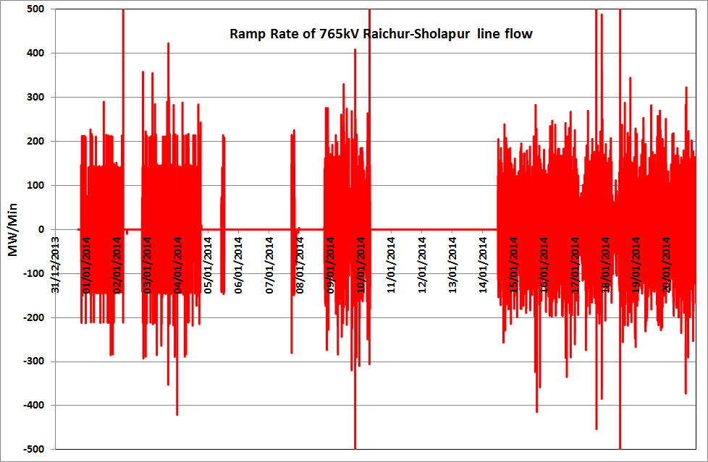
765kV Raichur-Sholapur Flow Ramp Rate (MW/Min)

Slide 20
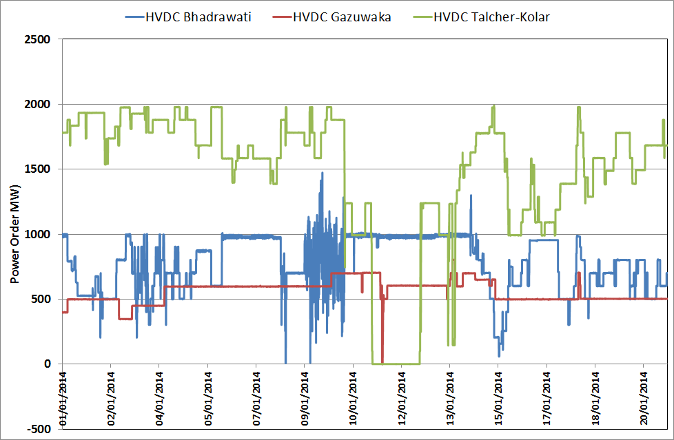
HVDC Set-point Variation
HVDC set-point variation was possible with STOA curtailment

Slide 21
Hz
%

Slide 22
Observations
Load and Generation changes in any of the regional grids leads to variation in line flow on 765 kV Sholapur-Raichur.
  Variable from +800 MW to -600 MW
  200 MW/minute ramp rate of SR load hour boundary
  Oscillations under observation………..uncharted territory
  5th harmonic increase observed at Bhadrawati
System currently operating with System Protection Schemes (SPS) and operator substituting for
  Primary response, secondary response as well as weaknesses in the transmission system

Slide 23
Challenges … (1)
Sudden increase in flow on 765kV Raichur-Sholapur flow leading to SPS operation.
    Hourly load changeover
    Intermittent nature of Wind generation in SR
    Tripping of largest unit in SR
Frequent synchronization & de-synchronization
Data telemetry
Frequent HVDC set-point toggling and STOA Curtailments

Slide 24
Challenges … (2)
Operation of defense plans (SPS and UFR)
Expectations of stakeholders for scheduled interchange of power on Raichur-Sholapur 765kV
More parallel AC corridors required
Frequency Band Tightening (tighten to 49.9 to 50.05 Hz from 17th Feb 2014) and Primary response
Line loading being controlled through
  Sensitizing SR states to regulate their generation and load meticulously to minimize impact on line loading
  Regulating flow on HVDC links to SR
  Keeping margins in the transmission for contingencies

Slide 25
Challenges … (3)
Twenty five (25) identified transmission elements to be expedited
  Only three (3) elements commissioned so far.
  Second 765 kV Sholapur-Raichur line by RSTCL required.
Implementation of the Unified Real Time Dynamic State Measurement System (URTDSM) project
Grid Security Expert System (GSES)
Secondary control through Automatic Generation Control or AGC as being adopted by large grids

Slide 26
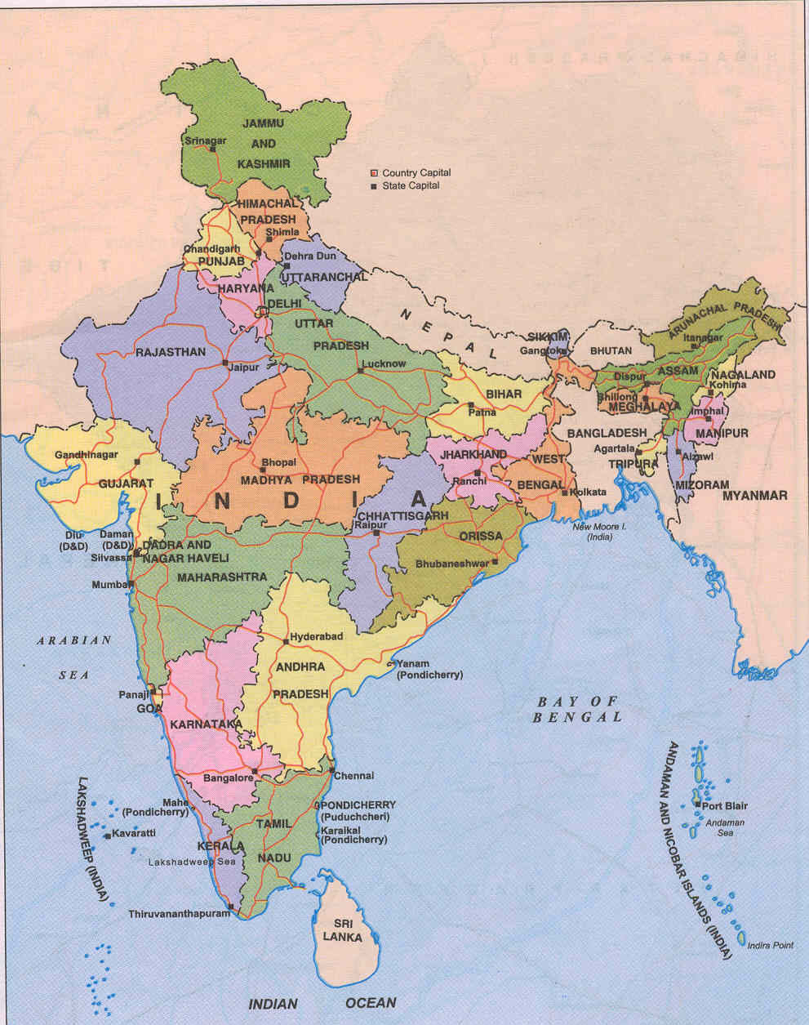
Peculiarities of Regional Grids in India
Deficit Region
Snow fed – run-of –the –river hydro
Highly weather sensitive load
Adverse weather conditions: Fog & Dust Storm
REGIONAL GRIDS
CHICKEN-NECK
NORTHERN REGION
Very low load
High hydro potential
Evacuation problems
NORTH-EASTERN REGION
EASTERN REGION
WESTERNREGION
Low load
High coal reserves
Pit head base load plants
SOUTHERN REGION
Industrial load and agricultural load
High load (40% agricultural load)
Monsoon dependent hydro
Notes:
June 27, 2014
NRLDC
26

Slide 27
Peculiarities of Indian Power System
Skewed resource distribution
Long-haulage of power
Resource Inadequacy
Weather extremes
Diversity

Slide 28
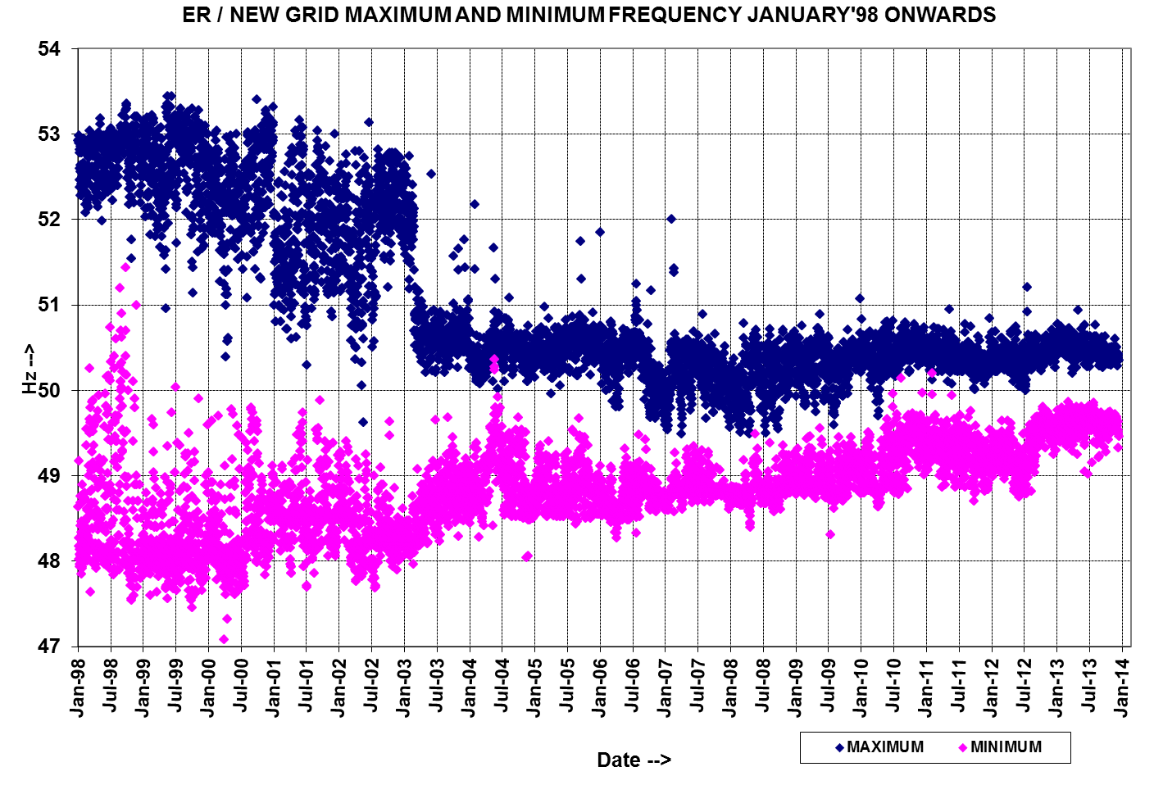

Slide 29
Inter-regional Transfer Capacity
NORTHERN REGION
8,720 MW
12,130 MW
NORTH-EASTERN REGION
6,490 MW
1,260 MW
WESTERNREGION
EASTERN REGION
3,620 MW
3,630 MW
SOUTHERN REGION

Slide 30
765 KV RING MAIN SYSTEM THE POWER ‘HIGHWAY’
HYDRO
HYDRO POWER FROM THE NORTH-EAST & CHEAP PIT HEAD THERMAL POWER FROM THE EAST ENTERS THE RING AND EXITS TO POWER STARVED REGIONS

Slide 31
765 KV ring under construction
NR
1
NER
8
7
2
6
3
5
4
ER
WR
Agra
Gwalior
Bina
Seoni
Sipat
Ranchi
Balia
Fatehpur
SR

Slide 32
2 x1500 MVA ICT
240 MVA L/R
2x 240 MVAR B/R
Present 765kV GRID MAP
MEERUT
2 x1500 MVA ICT
1 X 240 MVAR B/R
LUCKNOW
MOGA
2 x1500 MVA ICT
240 MVAR B/R
240MVAR L/R
2 x1500 MVA ICT
2x 240 MVAR B/R
240 MVAR L/R
UNNAO
AGRA
2 x1000 MVA ICT
189 MVAR B/R
330 MVAR L/R
I – 273 kM
316 kM
2 x1500 MVA ICT
2 x 240 MVAR B/R
240 MVAR L/R
* USED AS B/R
II- 128 kM
I - 129 kM
2 x1500 MVA ICT
330 MVAR B/R
2 x 330 MVAR L/R
FATEHPUR
409 kM
2 x1000 MVA ICT
189 MVAR B/R
330 MVAR L/R
BHIWANI
2 x1000 MVA ICT
2 x 240 MVAR B/R
245 kM
GWALIOR
BALIA
2 x1500 MVA ICT
2 x 240 MVAR L/R
335 kM
ANPARA C
85 kM
I - 234 kM
*
JHATIKARA
II- 235 kM
SATNA
2 x1000 MVA ICT
2 x 240MVAR L/R
240 MVAR B/R
1 x 1500 MVA ICT
1 x 330 MVAR B/R
BINA
2 x1000 MVA ICT
5 x 240MVAR L/R
1x 240 MVAR B/R
340 kM
4x1500 MVA ICT
1x 240 MVAR B/R
1x 240 MVAR L/R
SASARAM
243 kM
246 kM
SASAN
145 kM
I - 274 kM
330 MVAR Mid
Point REACTOR
I – 310 kM
1 x1000 MVA ICT
II - 276 kM
GAYA
3 x1500 MVA ICT
2 x 240 MVAR B/R
240 MVAR L/R
BILASPUR
INDORE
292 kM
3 x1500 MVA ICT
240 MVAR B/R
2x 240 MVAR L/R
RAICHUR
SEONI
I - 337 kM
I - 22 kM
2 x1500 MVA
3 x1500 MVA ICT
240 MVAR B/R
3x 240 MVAR L/R
2 x 240MVAR L/R(Fut.)
II - 338 kM
II - 22 kM
208 kM
I – 268 kM
Dharamjaygarh
SIPAT
2 x1000 MVA ICT
2 x 240MVAR L/R
240 MVAR B/R
2 x1500 MVA ICT
II - 261 kM
303 kM
SOLAPUR
RANCHI
2 x1500 MVA ICT
1 x 240MVAR L/R
240 MVAR B/R
WARDHA
400kV
3 x1500 MVA ICT
240 MVAR B/R
2 x 240 MVAR L/R
765kV charged at 400kV
765kV charged at 765kV
Future

Slide 33
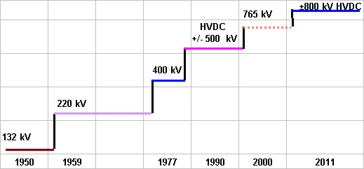
Transmission technology
Issues:
  Reactive Compensation in EHV/UHV
  Importance of lines of all voltage levels
  Short Circuit Levels

Slide 34
Inter Regional Exchange
Energy in MU

Slide 35
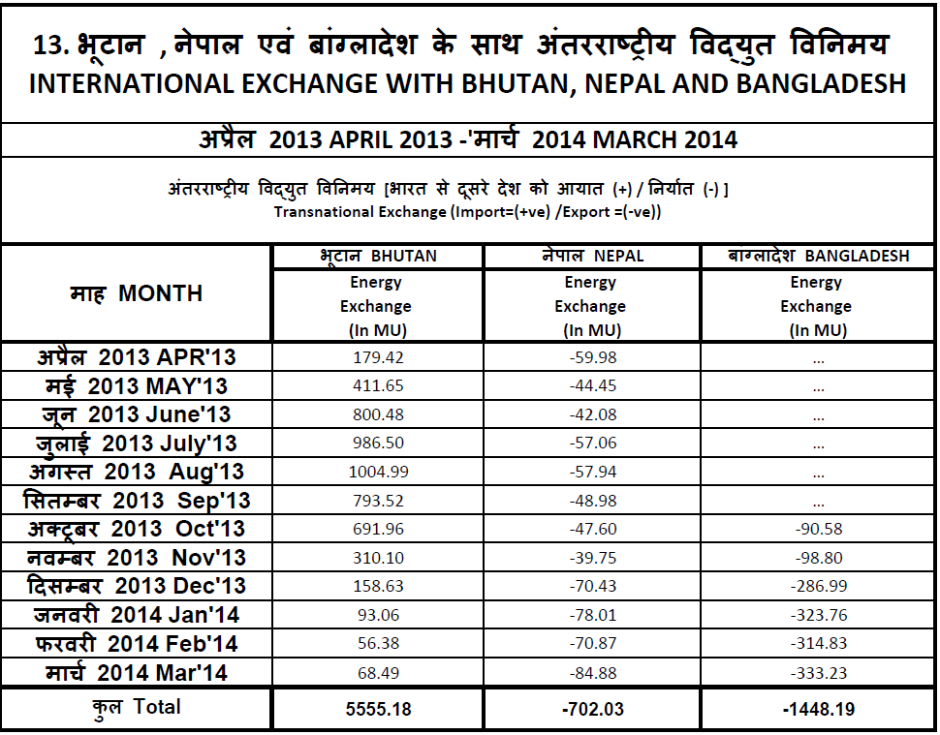

Slide 36
International Connections

Slide 37
International Connections
Bhutan
  Tala HEP (1020 MW) – 400 kV
  Chukha HEP (336 MW) – 220 kV
  Kurichu HEP (60 MW) – 132 kV
  Net import by India
Nepal
  Over 16 links of 132/33/11 KV
  Net export to Nepal (about 10% of Nepal’s demand)
Bangladesh
  500 MW B-t-B HVDC at Bheramara (Bangladesh)
  400 kV Berhampur (India) –Bheramara (Bangladesh) D/C
  LILO of Farraka-Jeerat at Bheramara
  Net export to Bangladesh
Future
  SAARC Grid
37

Slide 38
Transnational links between ER and Nepal
132 kV Valmikinagar-Surajpura(Nepal) S/C
132 kV Kataiyya(GSS)-Duhabi(Nepal) S/C
33 kV Kataiya-Rajbiraj (Nepal) S/C
33 kV Kataiya-Biragram (Nepal) S/C
33 kV Sitamarhi-Jaleshwar (Nepal) S/C
33 kV Rauxsaul-Birganj (Nepal) S/C
33 kV Jaynagar-Sirha (Nepal) S/C

Slide 39
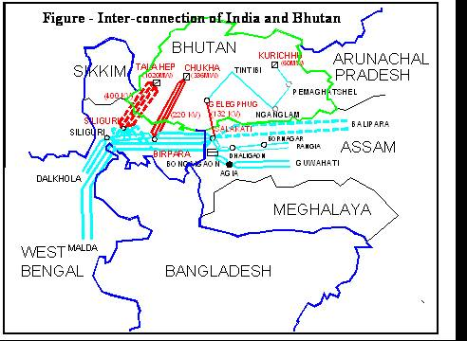
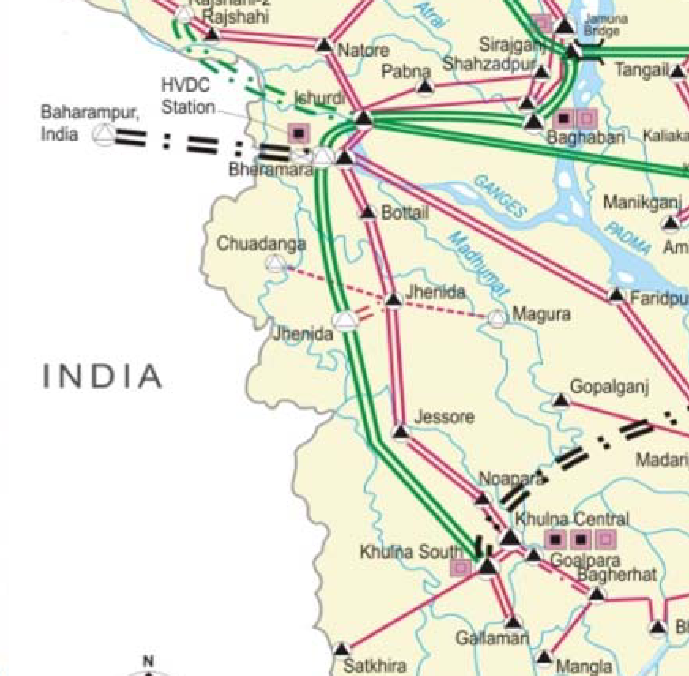
SAARC Grid
Nepal
Over 16 links of 132/33/11 KV Radial links with Nepal Net import by Nepal
India- Bhutan synchronous links
400 kV Tala-Binaguri D/C
400 kV Tala-Malbase-Binaguri
220 kV Chukha-Birpara D/C
220 kV Chukha-Malbase-Birpara
132 kV Kurichu-Gelegphug-Bongaigaon
Bhutan
India- Bangladesh asynchronous links
400 kV Bheramara (Bangladesh)–Berhampur (India) D/C
500 MW B-t-B HVDC at Bheramara (Bangladesh)
Bangladesh
Future Connections with Sri Lanka

Slide 40
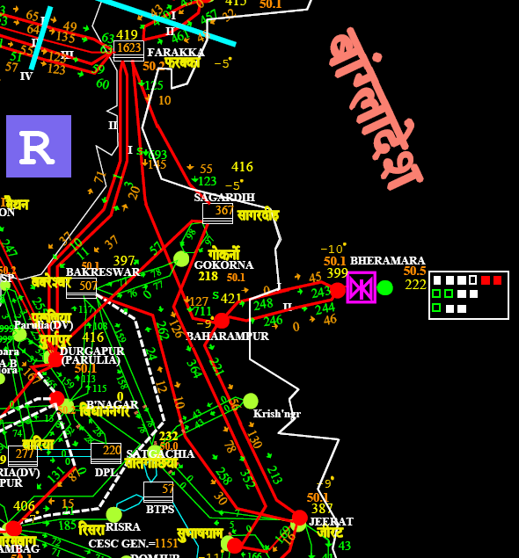
ASYNCHRONOUS INTERCONNECTION WITH BHUTAN

Slide 41
Power Transfer to Bangladesh
Present status
  400 kV D/C from Berhampur-Bheramara (Bangladesh)
  500 MW B-t-B HVDC terminal at Bhermara (Bangladesh)
  Started in month of October 2013
  Initially power transfer was restricted to 250 MW
  With commissioning of SPS (system protection scheme) power transfer is enhanced to 500 MW
Proposed lines
  400 kV HTSL (high tensile low sag) D/C line from Sagardighi-Berhampur.
  Proposed for reliable supply of 500 MW to Bangladesh through out the year.

Slide 42
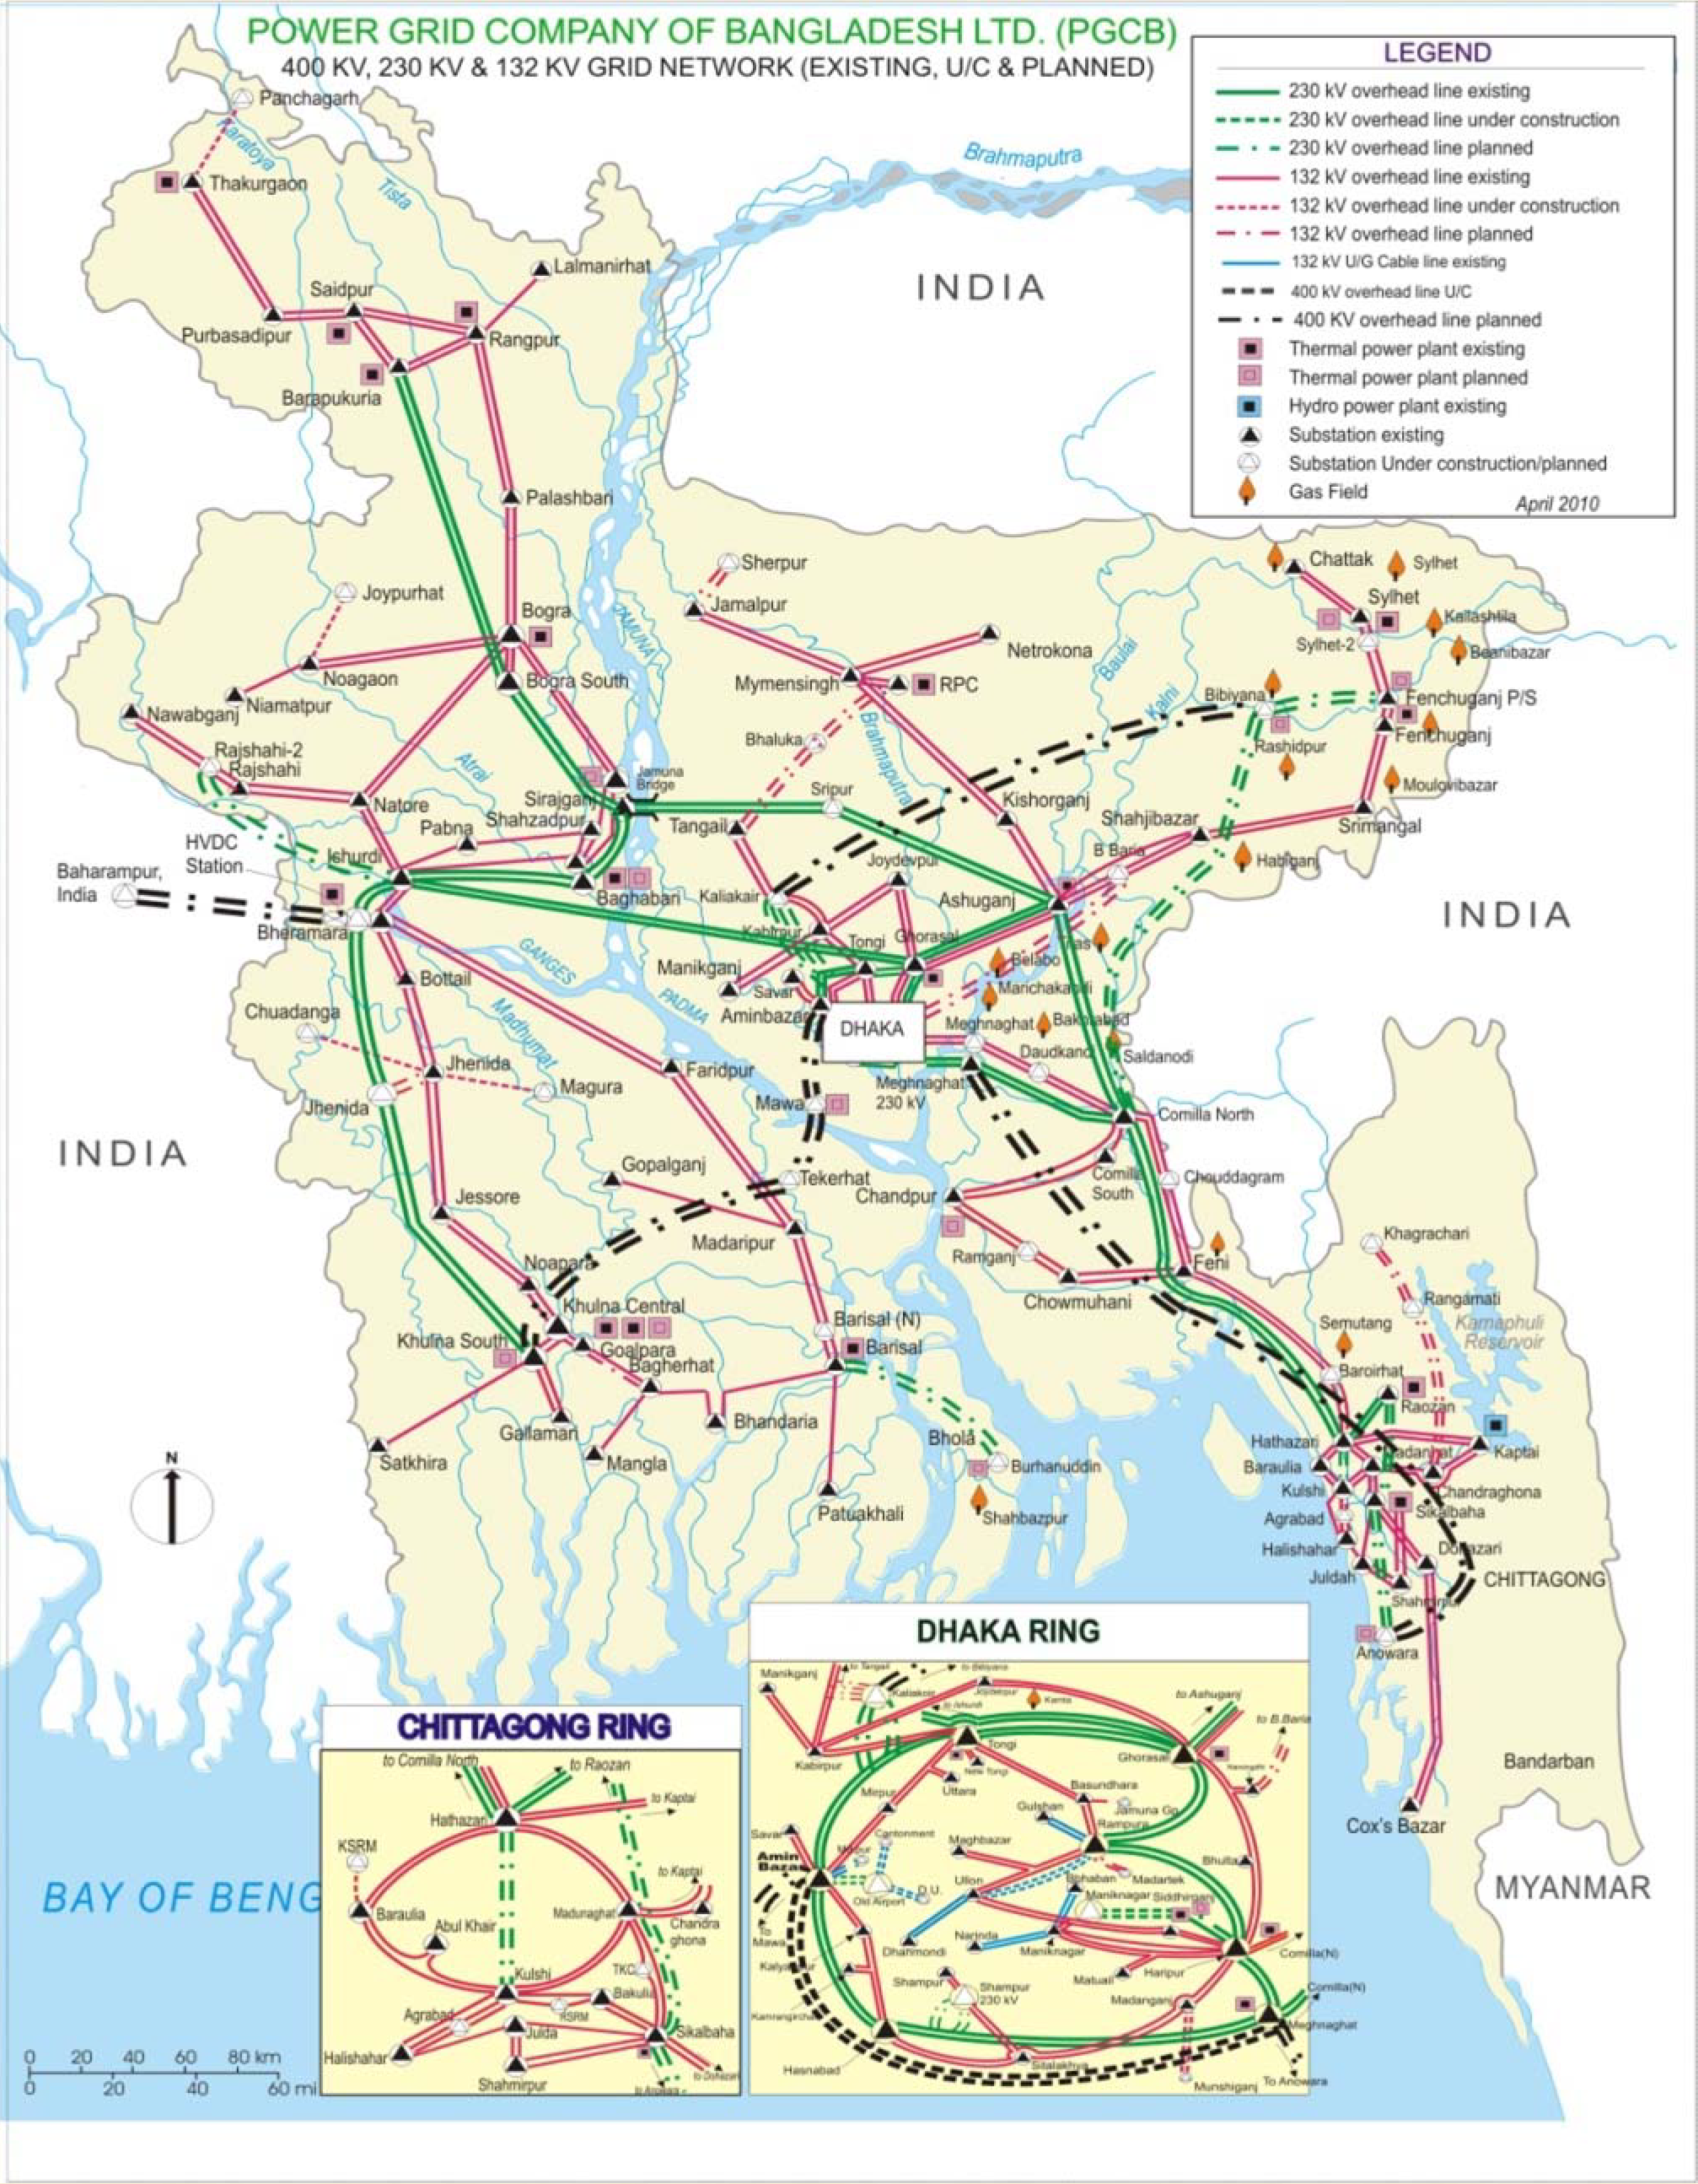
Power Map of Bangladesh

Slide 43
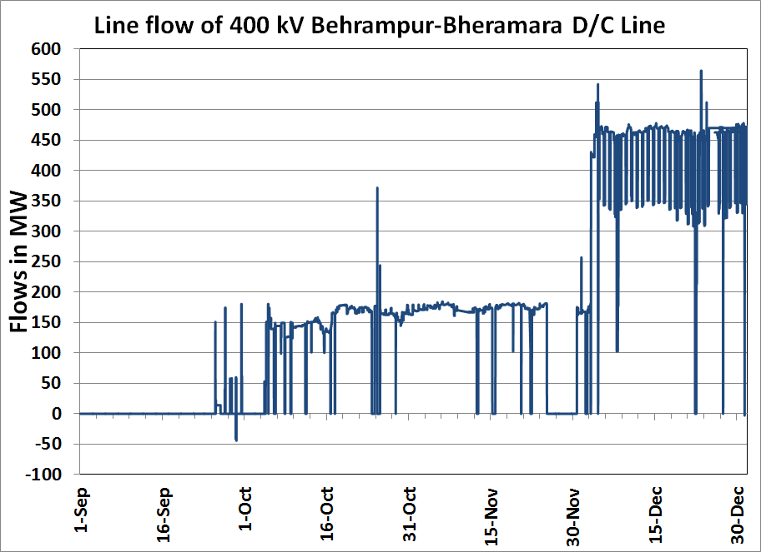

Slide 44
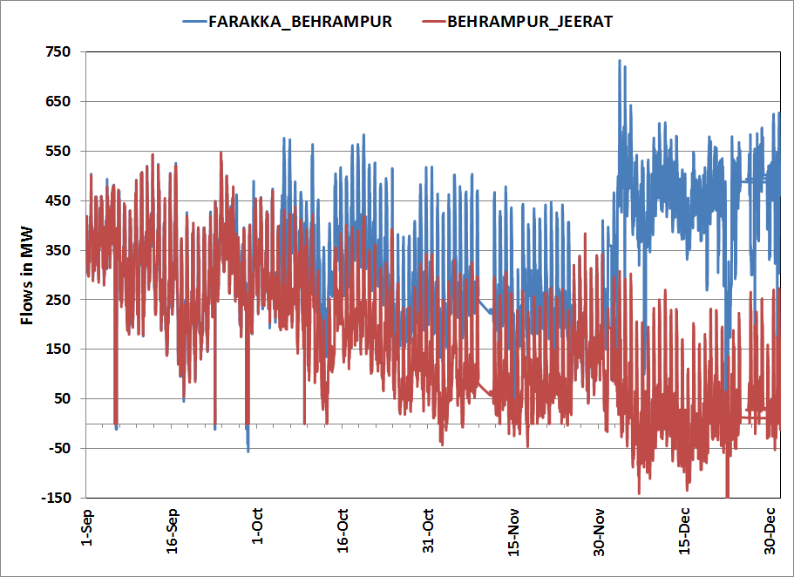
Line Flows(in MW)

Slide 45
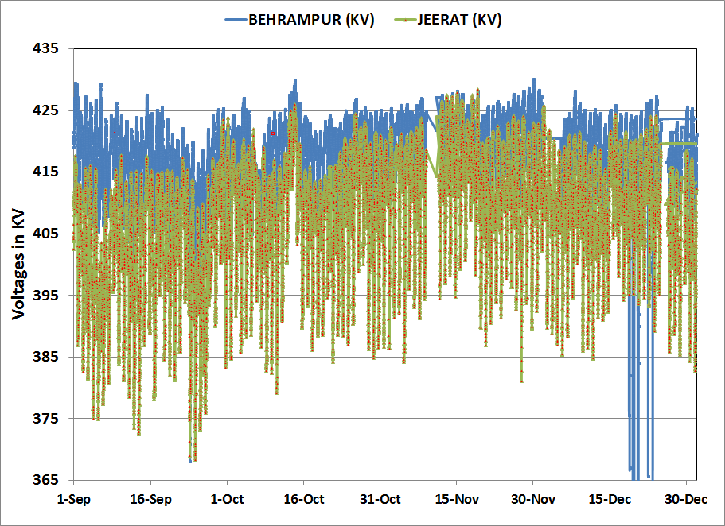
Voltage (in kV)

Slide 46
Jeerat Voltage (Sep’13 – Dec’13)

Slide 47
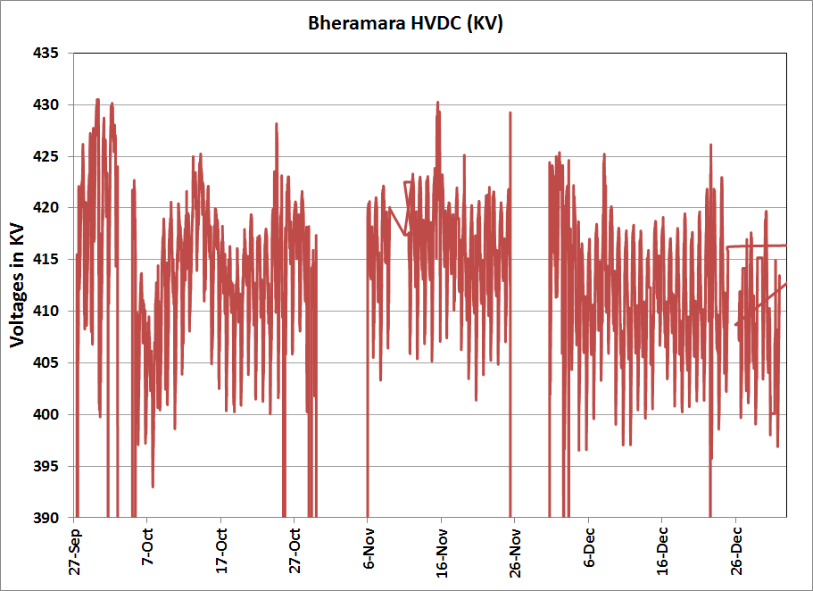
Bheramara Voltage (in kV)

Slide 48
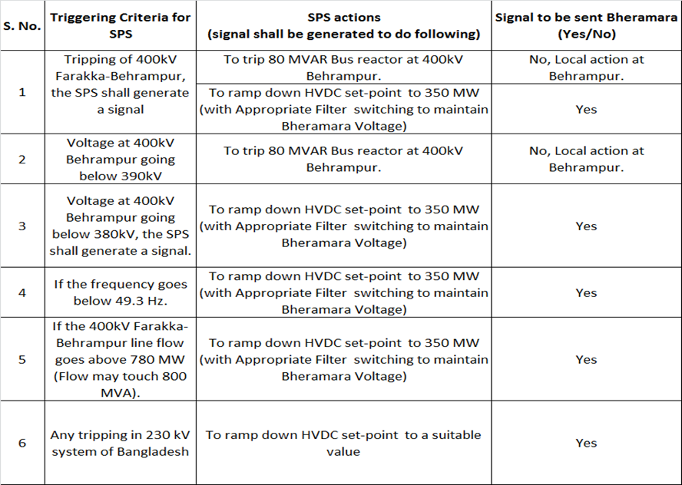
Special Protection scheme (SPS) to take care of contingency situation

Slide 49
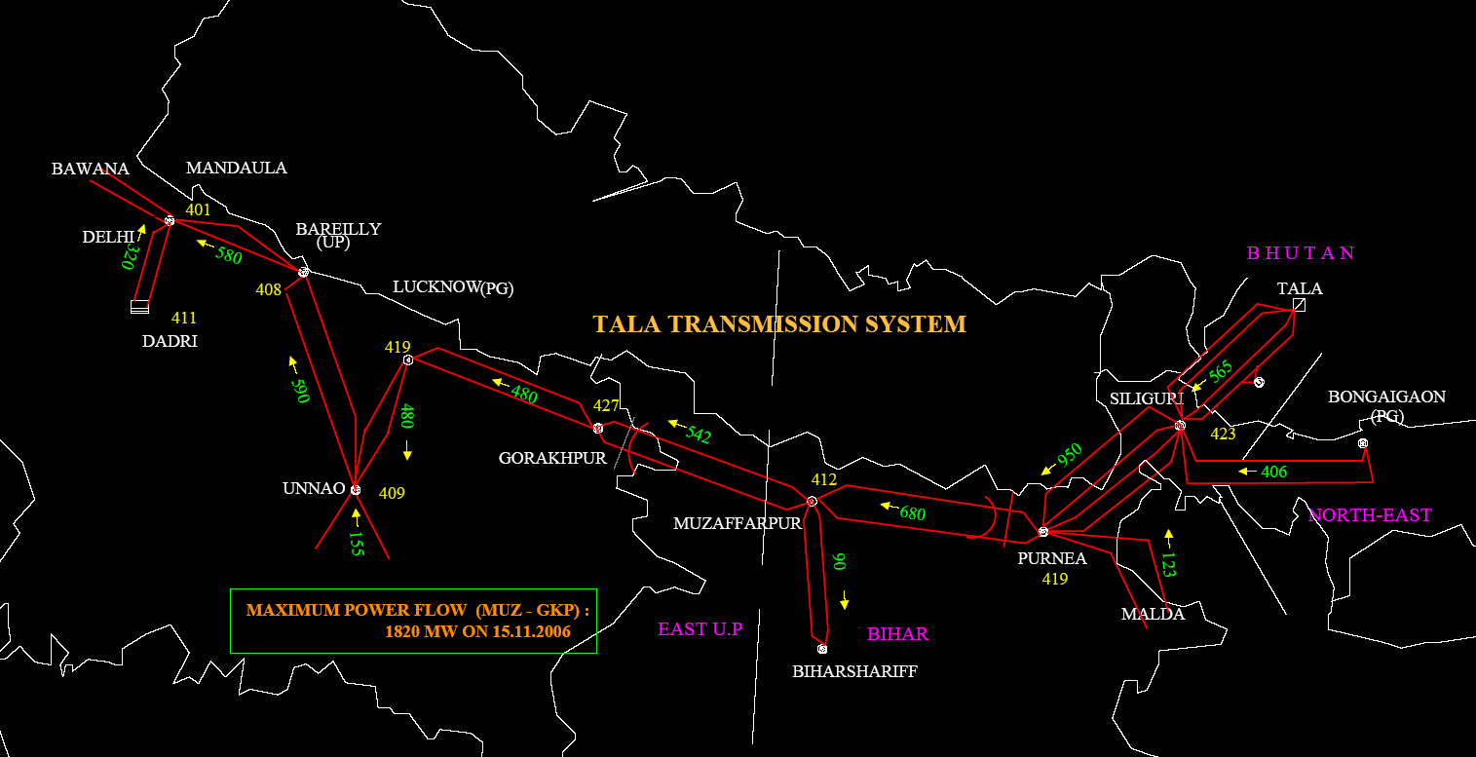
SYNCHRONOUS INTERCONNECTION WITH BHUTAN
3200 CIRCUIT KILOMETERS TALA TRANSMISSION SYSTEM
DELHI
TALA HEP 1020 MW (6x170 MW)
(BHUTAN)
BARELI
LUCKNOW
BINAGURI
PURNEA
GORAKHPUR
UNNAO
MUZAFFARPUR
2 x 139 + 2 x 144 kms. of
400 kV lines in Bhutan
NORTHERN GRID
EASTERN GRID
Snapshot from National Power System Desk

Slide 50
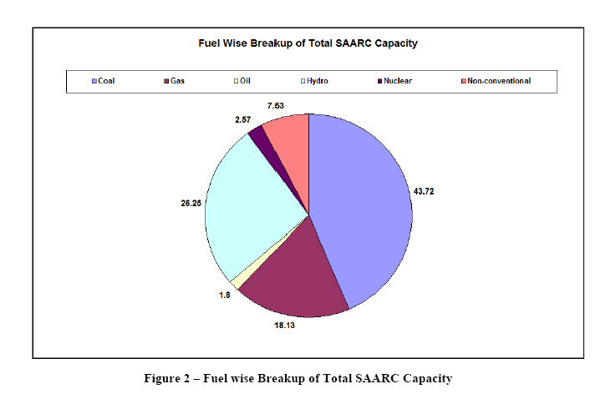

Slide 51
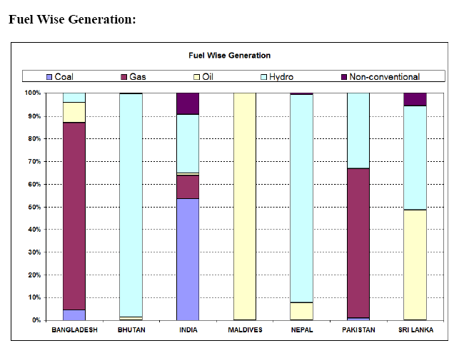
A fairly good Fuel Mix

Slide 52
Integration of Renewable Generation

Slide 53
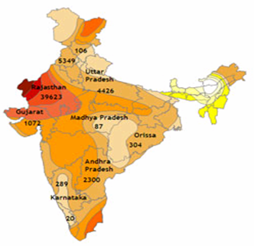
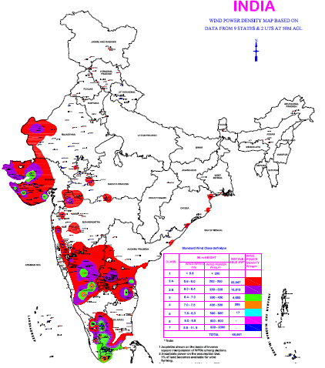
Unevenly Distributed Renewable Resources
SOLAR ENERGY MAP OF INDIA
WIND ENERGY MAP OF INDIA

Slide 54
Potential of Renewable Energy in India (MW)
Source | Potential | Installed Capacity
Wind | 49000 | 20298
Biomass | 17000 | 1286
Small Hydro (< 25 MW) | 15000 | 3774
Co-generation- Bagasse | 5000 | 2512
Waste | 2700 | 99
Solar | > 100,000 | 2208
Source : MNRE as on 31st Jan 2014
54
Notes:
54

Slide 55
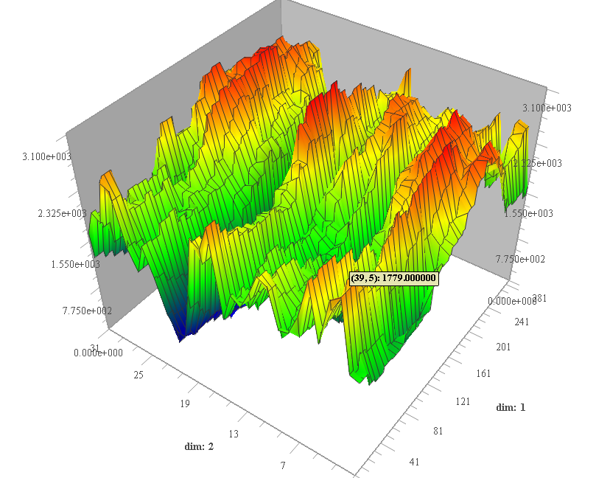
Fluctuations in Wind Generation
MW
For Tamil Nadu
Aug 2010
DATE
TIME

Slide 56
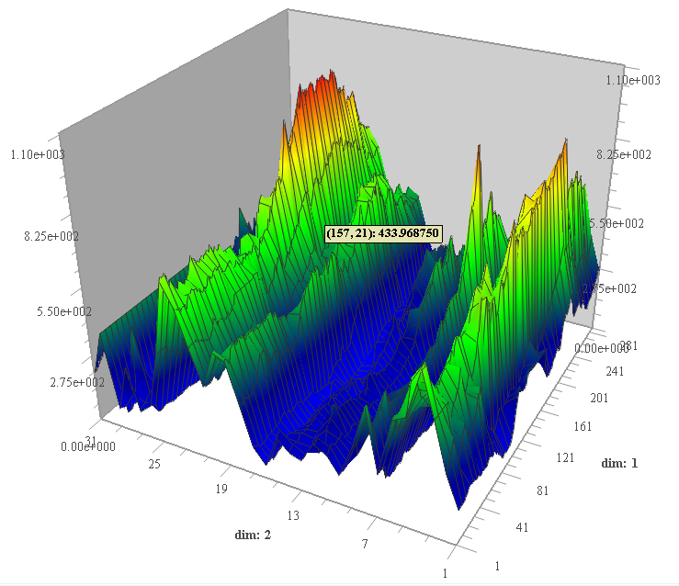
Fluctuations in Wind Generation
MW
For Gujarat
Aug 2010
DATE
TIME

Slide 57
Renewable Integration
Key Challenges
  High Capital Cost
  Intermittency of Generation
  Forecasting techniques
  Separate control desk for renewables
  Having ancillary services in place
Standards for renewable integration
  Fault Ride Through Capability
  High Frequency Tripping
High Capacity Corridors for Renewable evacuation
  Evacuation through HVDC
  National Transmission Highway from TN to Rajasthan

Slide 58
Power System in Extremes

Slide 59
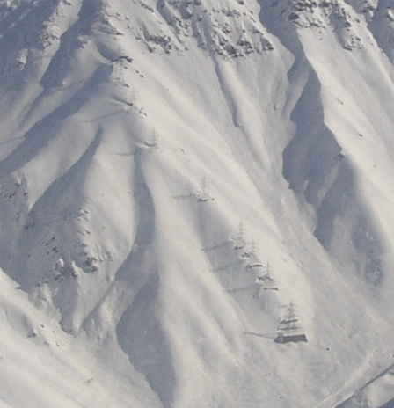
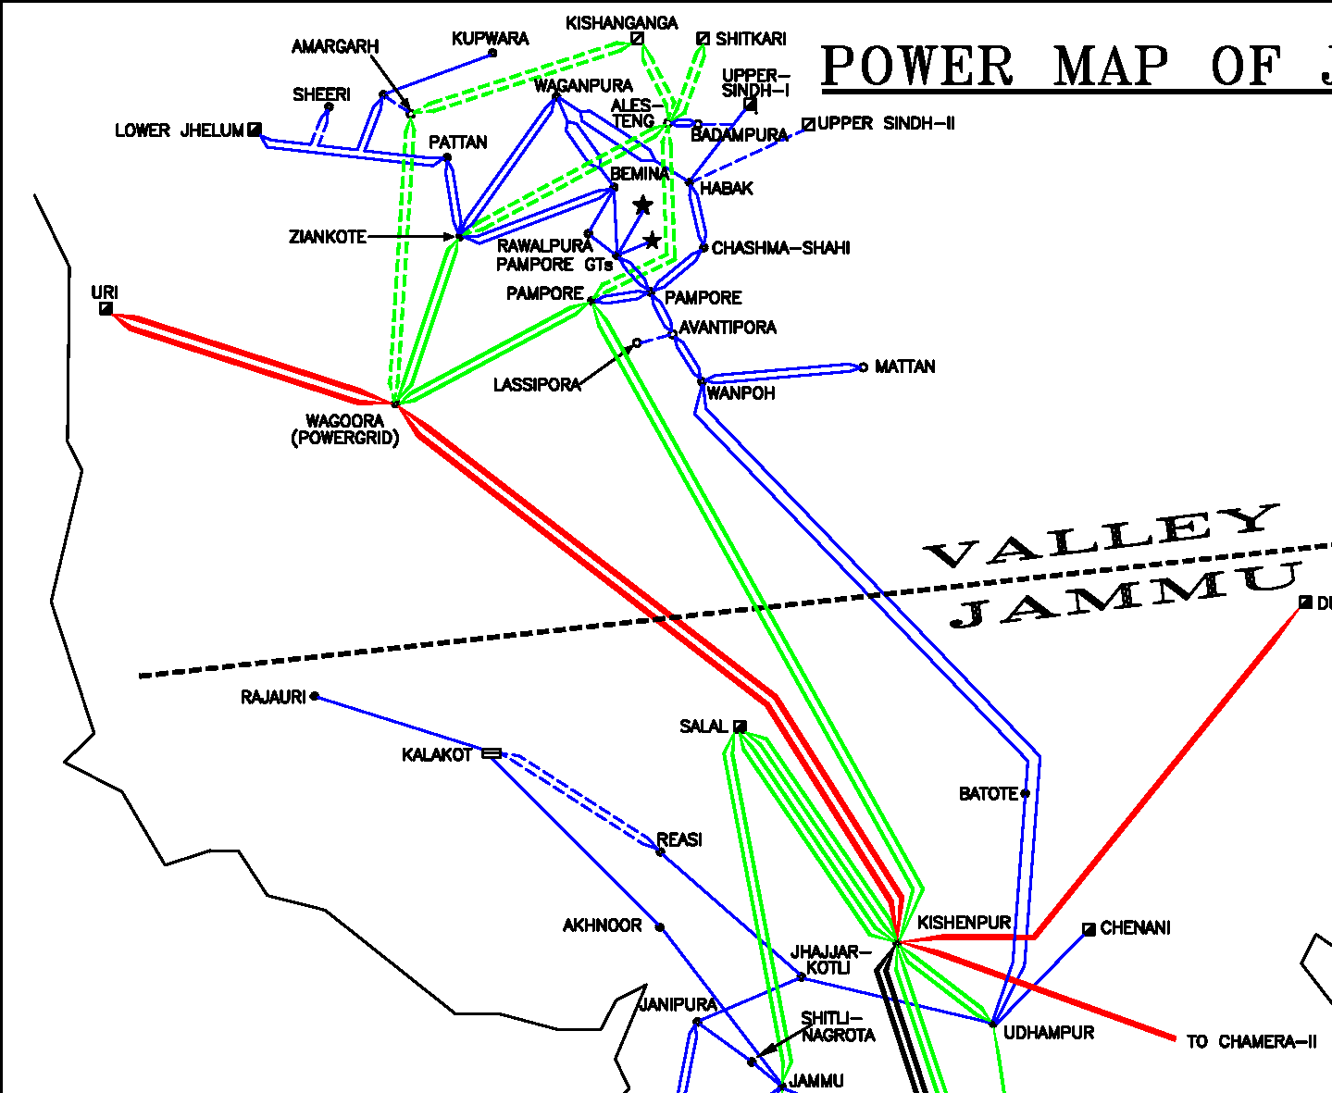
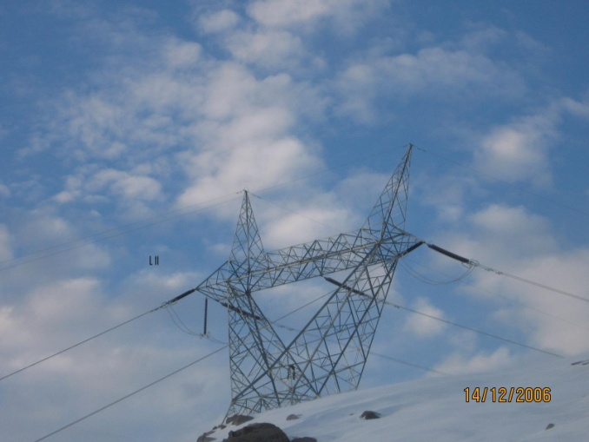
UNPRECEDENTED SNOWFALL AND BLIZZARD
12 meters of snowfall in Feb 2005,
Highest snowfall in last 30 years.
Previous highest of 4.5 meters was
recorded in February 1967.
220 kV
Kishenpur-Pampore
PIR PANJAL
MOUNTAIN RANGE
174 km
180 km
105 km
400 kV
Kishenpur-Wagoora
was commissioned on
31st Oct-2006
Notes:
The longest time for which the Kashmir island operated continuously was 2 hours and 15 minutes on 13th Feb 2005.
At 1832 hrs of 08th February 2005, the towers of 220 kV Kishenpur-Pampore D/C line at location number 38, 39, 44 and 45 near Peer Panjal area (90 km from Srinagar) collapsed and the valley plunged into darkness as the power supply to the valley was cut-off. The tower location was inaccessible due to heavy snowfall. The tower location was inaccessible due to heavy snowfall. Line restoration through ERS was ruled out due the risk of avalanches. The closure of the Jammu-Srinagar highway compounded the problems and made the restoration and relief work almost impossible.
The parallel operation through the 132 kV single circuit continued for several weeks till the 220 kV Kishenpur-Pampore line was restored on 07th March 2005. The conductors of 220 kV Kishenpur-Pampore line near the damaged tower were buried under the snow and the line had be restored using the Panther conductors (instead of Zebra conductors used in 220 kV lines) of the unused 132 kV Udhampur-Batote-Wampoh S/C. This amounted to a reconfiguration of Kishenpur-Pampore line wherein the towers of 132 kV Udhampur-Batote-Wampoh were also used. The original configuration was later restored in August 2005.
400 kV Kishenpur-Wagoora commissioned in

Slide 60
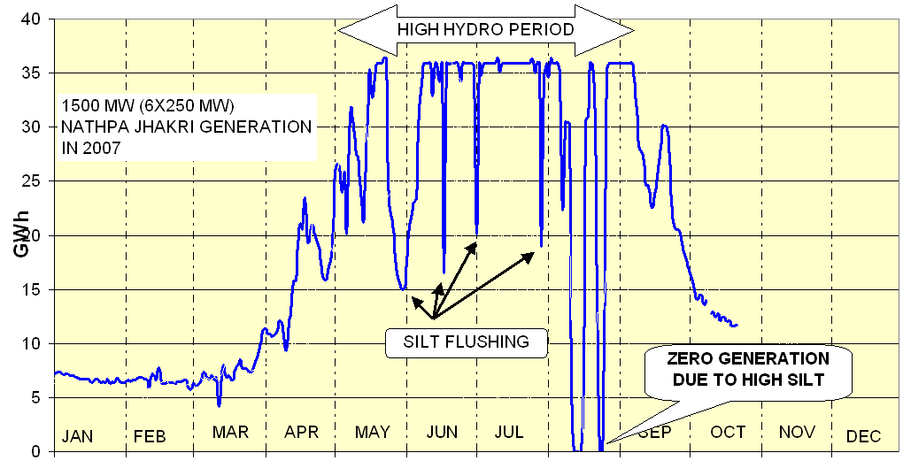
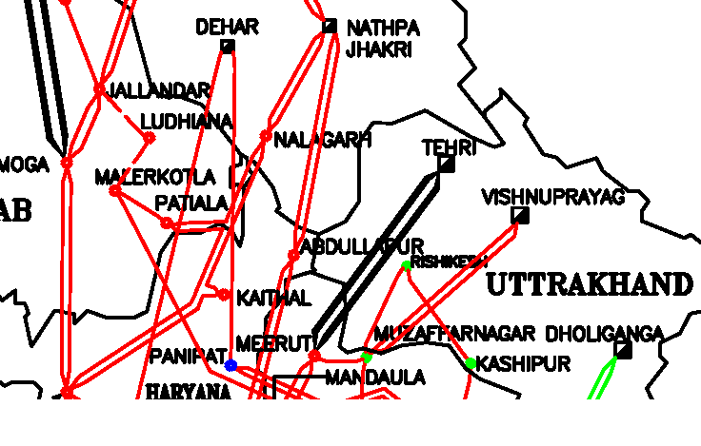
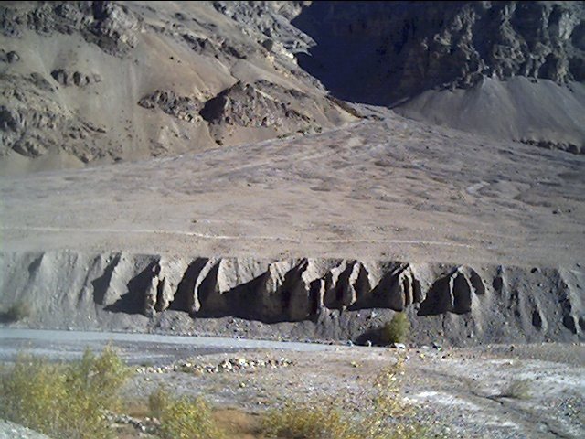
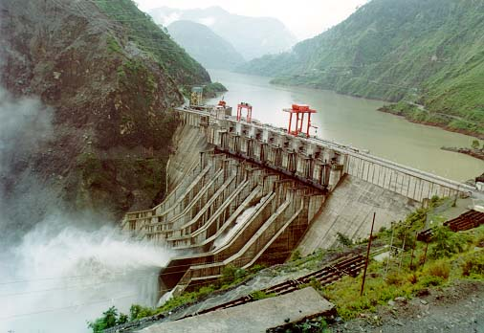
IMPACT OF SILT ON GRID OPERATION
SILT DEPOSITS
SPITI RIVER

Slide 61
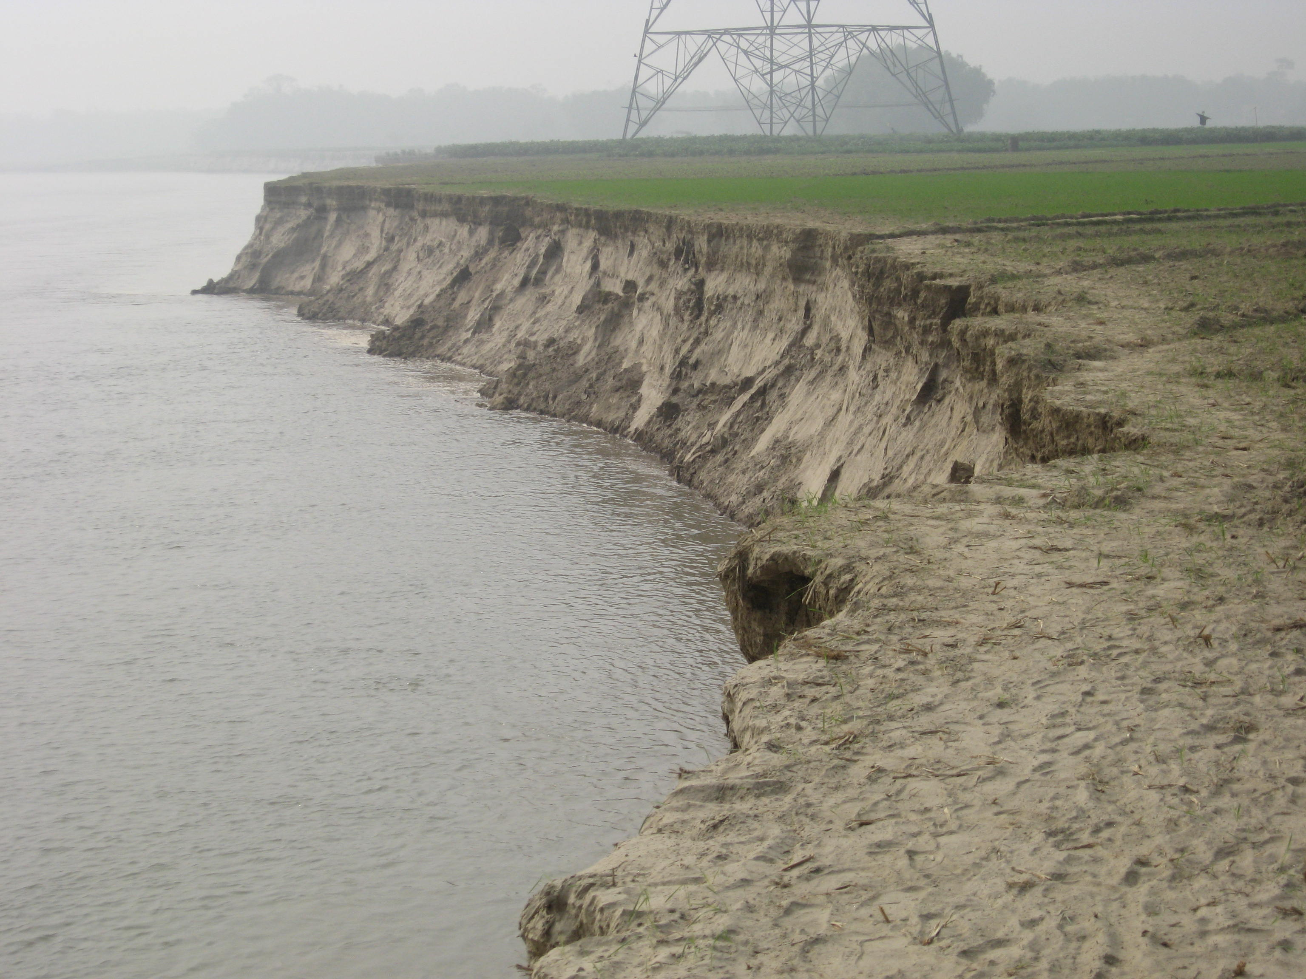
CHANGE OF KOSI RIVER COURSE

Slide 62
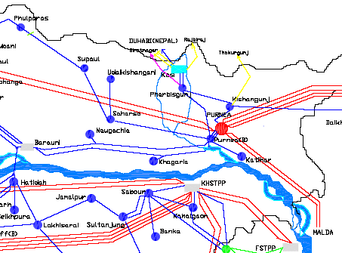
CHANGE OF RIVER COURSE
Original river course
Changed river course

Slide 63
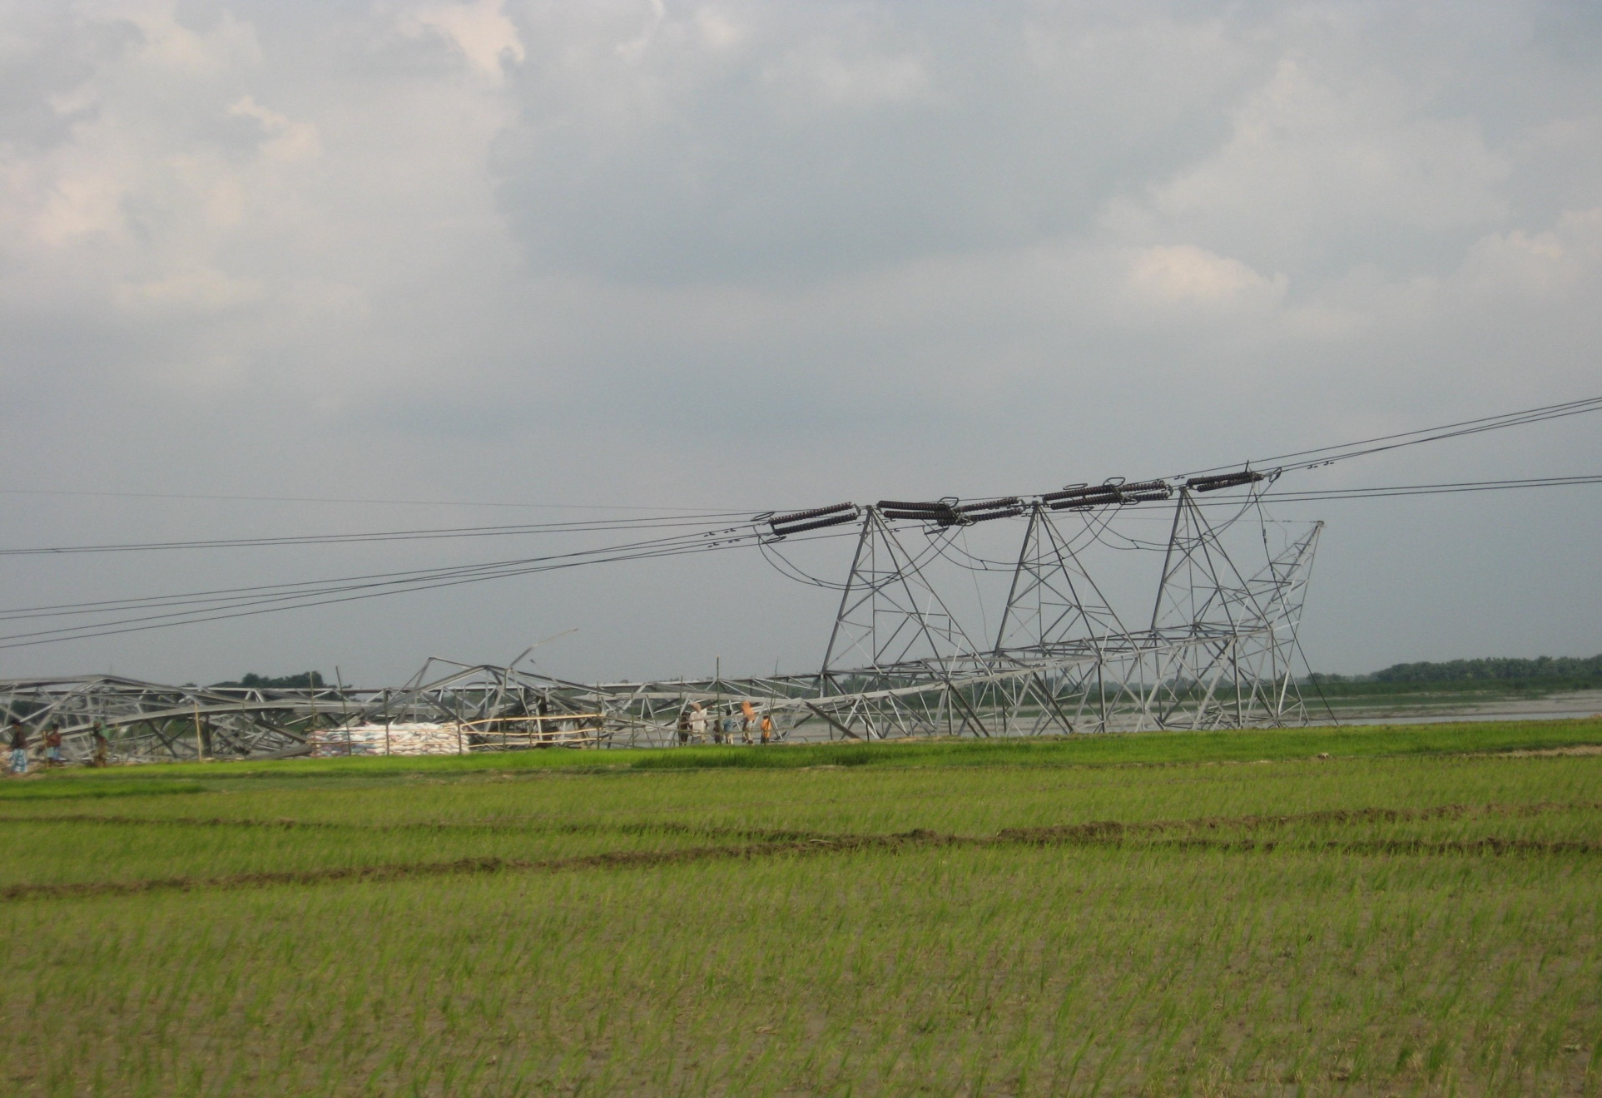
TOWER COLLAPSE DUE TO
SHIFTING OF RIVER

Slide 64
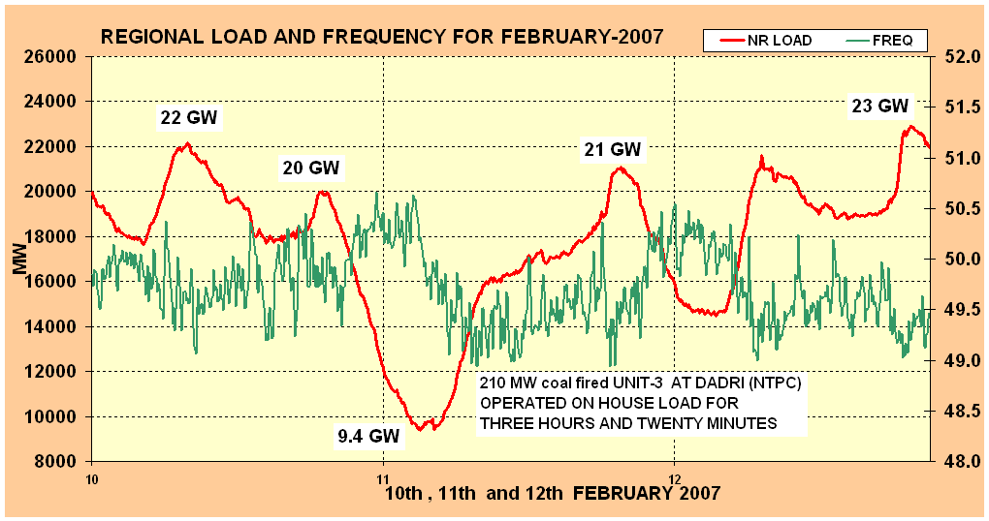
UNFORESEEN LOAD CRASH
8 HOUR TEST OF NERVES

Slide 65
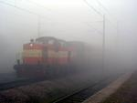
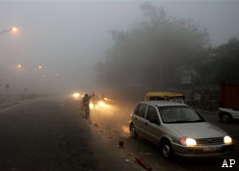
‘Killer Smog’

Slide 66
‘Killer Smog’

Slide 67
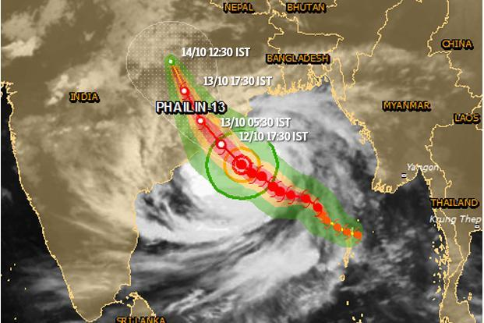
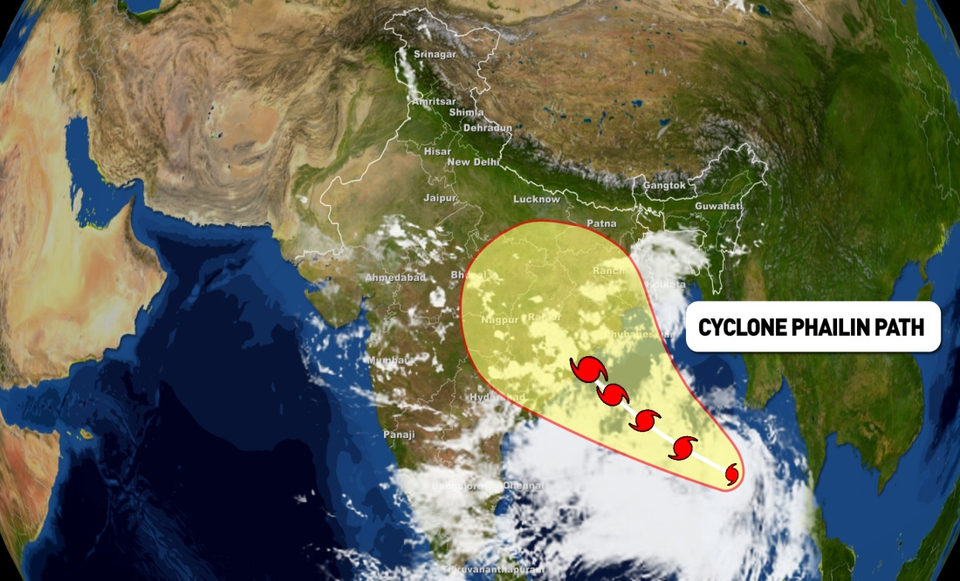
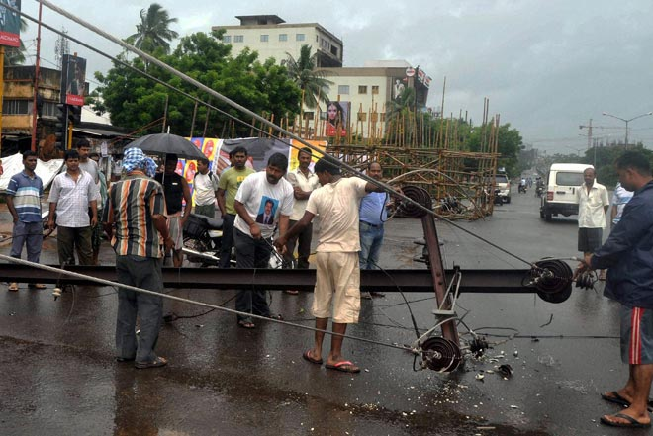
Phailin cyclone(12-Oct-2013), Huge Demand crash in Eastern Region in very short time
Demand crash of around 2000 MW in Odisha
26 Substation got affected
45 lines affected
220 kV Narendrapur-Mendasal-II still under breakdown

Slide 68
Thank You !!

